Slide 1

Gartner IT Services Market Share ETL Pipeline (2018-2023)
Objective:
Centralize access, analysis, and visualization of IT services market share data.
Scopes:
Analyze trends across vendors, markets, and segments.
Cover data from 2018 to 2023.
Build an optimized ETL pipeline for effective data processing.
Outcome:
Centralized data storage in a MySQL database for efficient querying and analysis
Successfully designed and implemented a scalable ETL pipeline to process IT services market share data from 2020 to 2023.
Addressed data inconsistencies, handled missing values, and standardized formats for seamless integration.
Created actionable insights and interactive visualizations using Power BI dashboards.
Enabled year-to-year growth analysis, regional revenue distribution, and vendor trends exploration.
Improved data
Problem Statement:
Data inconsistencies across years (2018-2023).
Lack of a centralized data repository for analysis.
Market definitions changed over time.
Project Goals:
Address inconsistencies.
Create a robust ETL pipeline.
Deliver comprehensive visualizations.

Slide 2
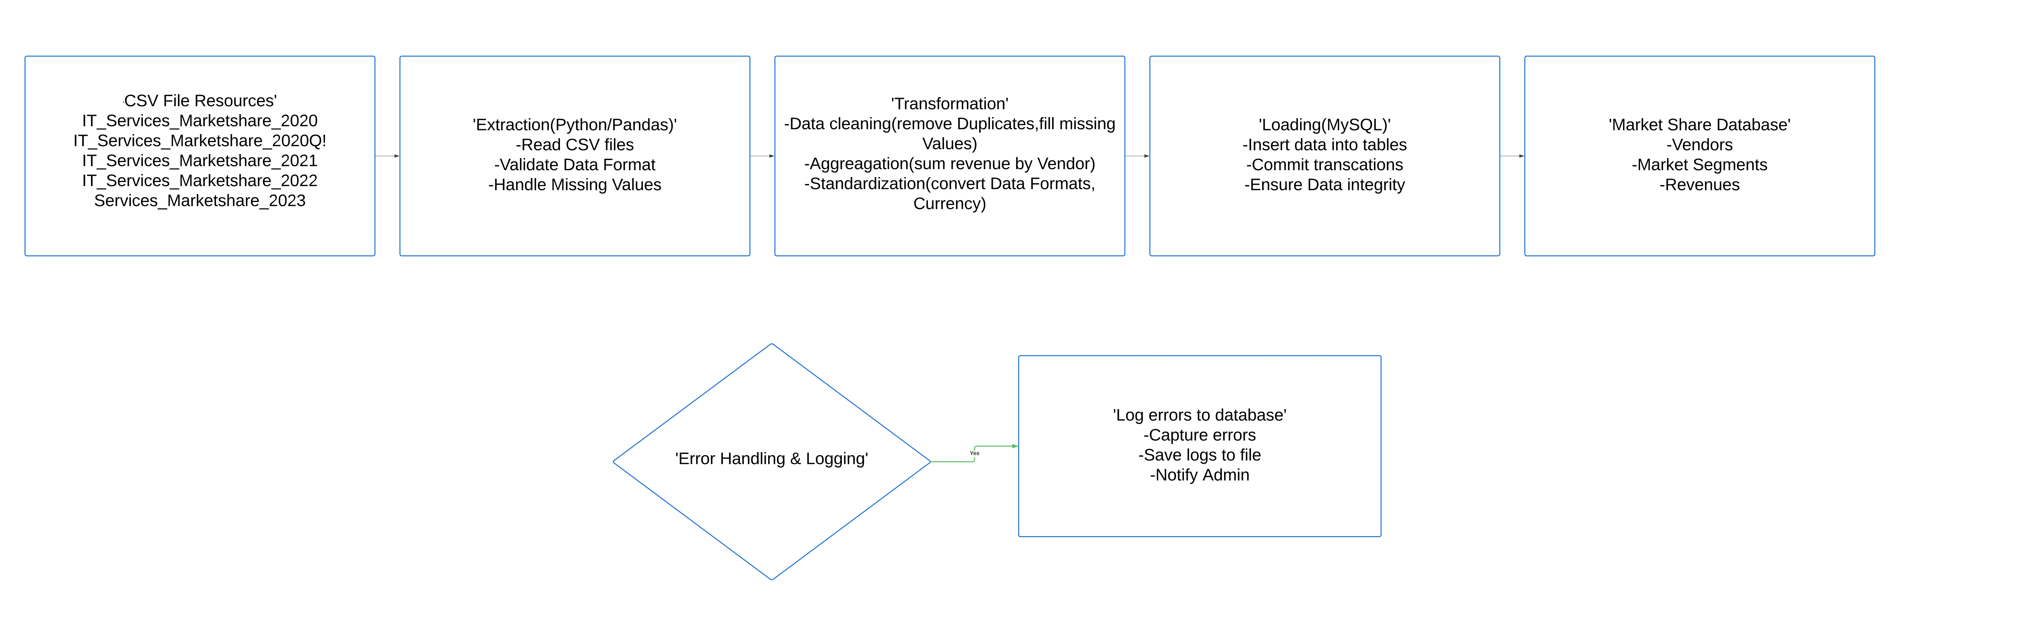
ETL Pipeline Architecture:
Segments:
CSV File Resources: 2018-2023 market share data.
Extraction: Read and validate data.
Transformation: Clean, aggregate, and standardize data.
Loading: Store data in a MySQL database.
Error Handling:
Log errors to a database.
Save logs to a file.
Notify admin in case of critical failures.
ETL Flowchart:

Slide 3
Data Mapping:
Key Transformations:
Source Column | Target Column | Data Type | Transformation Needed
Year | Year | INT | Convert to integer
Region | Region | VARCHAR(100) | Standardize naming
Country | Country | VARCHAR(50) | Convert to uppercase
Vendor | Vendor | VARCHAR(255) | Trim spaces, capitalize words
Service 1 | Service_1 | VARCHAR(100) | Remove special characters
Service 2 | Service_2 | VARCHAR(100) | Remove special characters
Service 3 | Service_3 | VARCHAR(100) | Remove special characters
Vertical | Vertical | VARCHAR(100) | Standardize naming
Ticker | Ticker | VARCHAR(50) | Convert to uppercase
HQ Country | HQ_Country | VARCHAR(50) | Convert to uppercase
VendorRevenue - USD | VendorRevenue_USD | DECIMAL(15,2) | Remove $ and commas
ConstantCurrency Revenue - USD | ConstantCurrency_Revenue_USD | DECIMAL(15,2) | Remove $ and comma

Slide 4
Implementation Steps :
Python-Based ETL Pipeline :
Extraction:
Read CSV files using Pandas.
Handle large datasets with chunk processing.
Transformation:
Standardize column names.
Handle missing values.
Convert data formats (e.g., currency).
Loading:
Insert transformed data into MySQL.
Error Handling:
Log errors in a centralized file (ETL_Pipeline.log).
Python Script :
import pandas as pd
import mysql.connector
import logging # For logging configuration
logging.basicConfig(
filename= 'ETL_Pipeline.log',
level=logging.INFO,
format='%(asctime)s - %(levelname)s - %(message)s’
) # Uploading of CSV files
CSV_FILES = [
r"D:\ETL_Project\IT_Services_Marketshare_2019.csv",
r"D:\ETL_Project\IT_Services_Marketshare_2020.csv",
r"D:\ETL_Project\IT_Services_Marketshare_2021.csv",
r"D:\ETL_Project\IT_Services_Marketshare_2022.csv",
r"D:\ETL_Project\IT_Services_Marketshare_2023.csv“] # MySQL connection details
mydb = mysql.connector.connect(
host="localhost",
user="root",
password="root",
database="market_data“) DB_TABLE = "market_data"

Slide 5
logging.info('Connected to MySQL successfully’)
#This function is to retrieve table columns from the database
def get_table_columns(connection, table_name):
cursor = connection.cursor()
cursor.execute(f"DESCRIBE {table_name}")
columns = [row[0] for row in cursor.fetchall()]
cursor.close()
return columns
# Function to process each chunk of data and insert it into MySQL
def process_chunk(chunk, table_name, connection, table_columns):
try:
# Standardization of column names
chunk.columns = [col.strip().replace(" - ", "_").replace(" ", "_").replace("-", "_") for col in chunk.columns]
# Rename of specific columns to match SQL table schema
chunk.rename(columns={
'Super_Region': 'Super_Region',
'HQ_Country': 'HQ_Country',
'VendorRevenue_USD': 'VendorRevenue_USD',
'ConstantCurrency_Revenue_USD': 'ConstantCurrency_Revenue_USD',
}, inplace=True) # For removal of 'Yr' from Year col
if 'Year' in chunk.columns:
chunk['Year'] = chunk['Year'].astype(str).str.replace(' YR', '', regex=False).astype(int)
# Replacing missing values
chunk.fillna("Unknown", inplace=True)
# Transformation of currency fields to numeric values
currency_VendorRevenue_USD", "ConstantCurrency_Revenue_USD"]
for col in currency_columns:
columns = [" if col in chunk.columns:
chunk[col] = chunk[col].replace({r'\$': '', ',': '', ' ': ''}, regex=True)
chunk[col] = pd.to_numeric(chunk[col], errors='coerce').fillna(0) # For the alignmwnt of columns with the database schema
chunk = chunk[[col for col in chunk.columns if col in table_columns]]

Slide 6
# Inserting the data into MySQL
cursor = connection.cursor()
cols = ", ".join(chunk.columns)
placeholders = ", ".join(["%s"] * len(chunk.columns))
insert_query = f"INSERT INTO {table_name} ({cols}) VALUES ({placeholders})" # Inserting all rows in the chunk
cursor.executemany(insert_query, chunk.values.tolist())
connection.commit()
cursor.close() logging.info(f"{len(chunk)} rows processed and inserted successfully.") except Exception as e:
logging.error(f"Error processing chunk: {e}") # Get the database table schema to ensure column alignment
table_columns = get_table_columns(mydb, DB_TABLE) # Process each CSV file in chunks
for file in CSV_FILES: try:
logging.info(f"Processing file: {file}")
chunksize = 100000 for chunk in pd.read_csv(file, chunksize=chunksize):
process_chunk(chunk, DB_TABLE, mydb, table_columns)
logging.info(f"Finished processing file: {file}")
except Exception as e:
logging.error(f"Error processing file {file}: {e}") # Close the database connection
mydb.close() logging.info("Database connection closed.")
Database Schema :
create database market_data
use market_data;
create table market_data (
Year INT, Super_Region VARCHAR(255), Region VARCHAR(255), Country VARCHAR(255), Vendor VARCHAR(255), Service_1 VARCHAR(255), Service_2 VARCHAR(255), Service_3 VARCHAR(255), Vertical VARCHAR(255), Ticker VARCHAR(255), HQ_Country VARCHAR(255),
VendorRevenue_USD DECIMAL(20, 7), ConstantCurrency_Revenue_USD DECIMAL(20, 7)
);

Slide 7
EXPLAIN SELECT Year, Vendor, Country, Service_1, Service_2, Service_3, Vertical, Ticker, HQ_Country, VendorRevenue_USD, ConstantCurrency_Revenue_USD, COUNT(*) AS Duplicate_Count FROM market_data GROUP BY Year, Vendor, Country, Service_1, Service_2, Service_3, Vertical, Ticker, HQ_Country, VendorRevenue_USD, ConstantCurrency_Revenue_USD HAVING COUNT(*) > 1 ; CREATE INDEX idx_year ON market_data (Year); CREATE INDEX idx_vendor_country ON market_data (Vendor, Country); CREATE INDEX idx_revenue ON market_data (VendorRevenue_USD); CREATE INDEX idx_currencyrevenue ON market_data (ConstantCurrency_Revenue_USD); SHOW INDEXES FROM market_data; SHOW TABLE STATUS LIKE 'market_data’; SHOW VARIABLES LIKE 'max_allowed_packet’; SHOW VARIABLES LIKE 'wait_timeout’; SHOW VARIABLES LIKE 'innodb_buffer_pool_size’; OPTIMIZE TABLE market_data; ANALYZE TABLE market_data;
Performance Optimization :
Indexing:
Created indexes on frequently queried columns (Year, Vendor, Country).
Chunk Processing:
Handled large CSV files efficiently.
MySQL Settings:
Adjusted max_allowed_packet and wait_timeout.
Query Optimization:
Used EXPLAIN to fine-tune SQL queries.
Performance Optimization Schema :

Slide 8
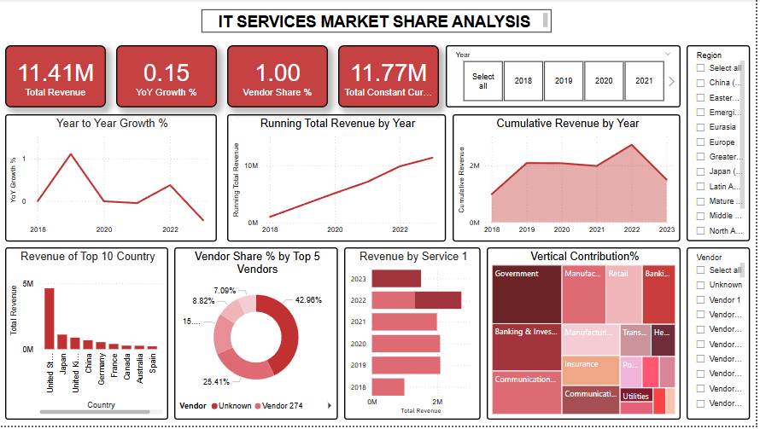
Power BI Dashboard :
Calculated the DAX measures as below
YoY Growth %: Calculates year-over-year growth percentage.
Vendor Share %: Calculates the percentage contribution of each vendor to total revenue.
Top 5 Vendors Revenue: Aggregates revenue for the top 5 vendors.
Regional Revenue: Calculates the total revenue for each region.
Constant Currency Revenue: Sums up revenue in constant currency USD.
Segment Contribution %: Measures the percentage revenue contribution by market segments.
Visualizations in the dashboard as below
KPI Cards: Displaying Total Revenue, Year-over-Year (YoY) Growth %, and Vendor Share %.
Line Chart: Tracking Year-over-Year Growth % by Year.
Bar Chart: Showing Revenue of Top 10 Countries.
Area Chart: Analyzing Regional Revenue Distribution over time.
Pie Chart: Highlighting Vendor Share % by Top 5 Vendors.
Treemap: Visualizing Revenue Contribution by Vendor and Market Segments.
Slicers: Interactive filters for Year, Region, Vendor, and Market Segments

Slide 9
Conclusion:
Achievements:
Designed and implemented a scalable ETL pipeline.
Integrated IT services market data from 2020 to 2023.
Delivered insights using Power BI dashboards.
Future Enhancements: Automate the pipeline for real-time updates.
Extend analysis to include additional years and datasets.
THANK YOU

